Slide 1
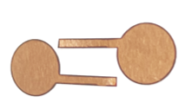
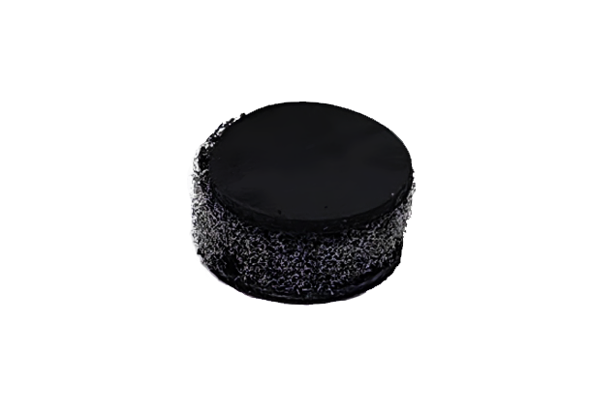
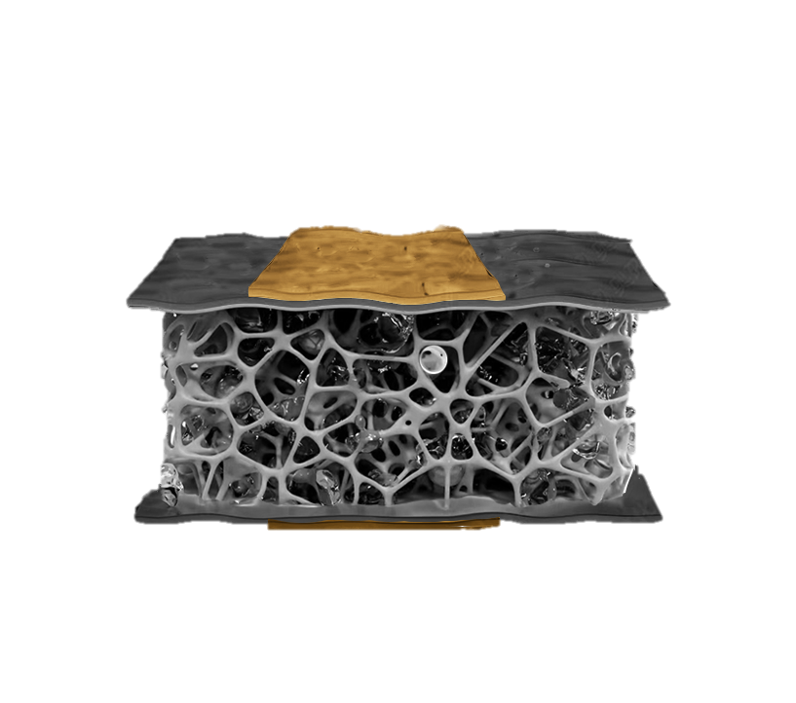
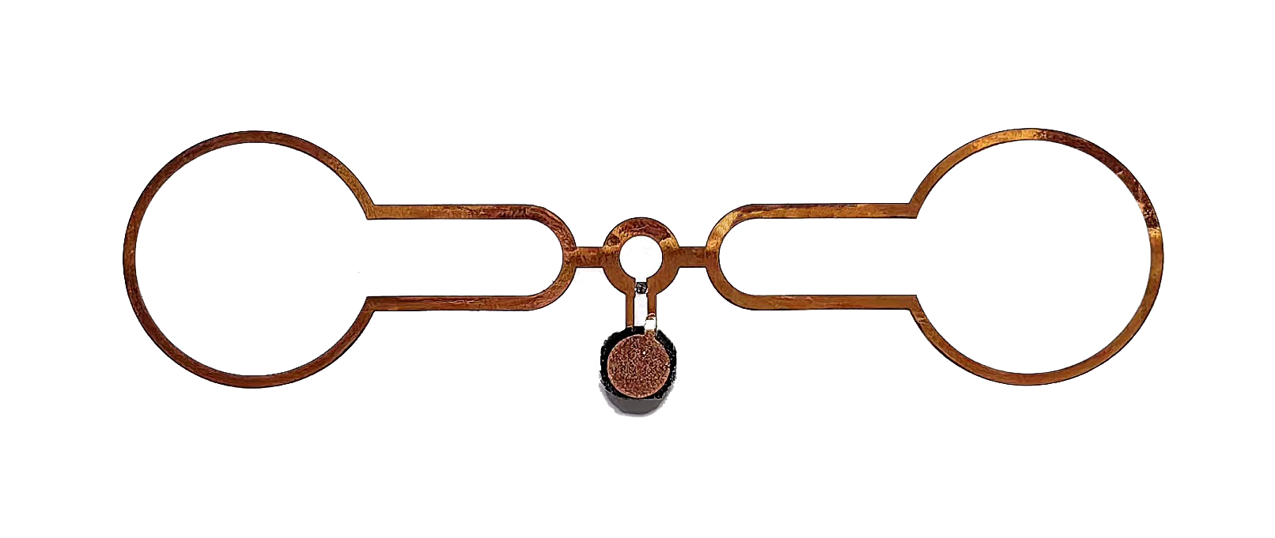
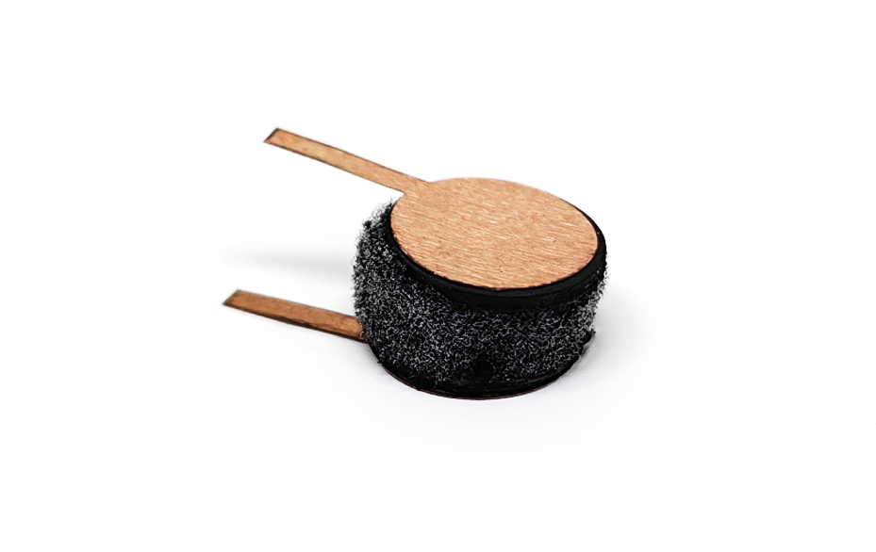
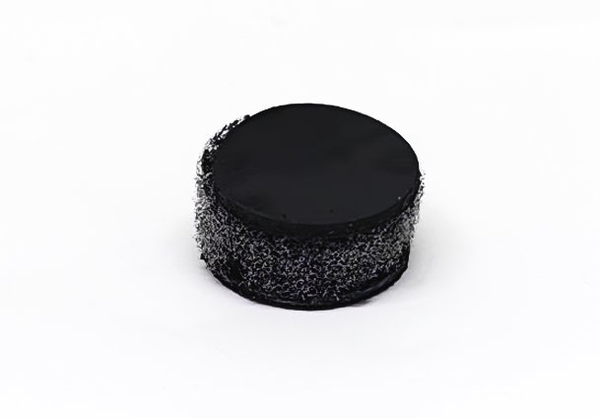
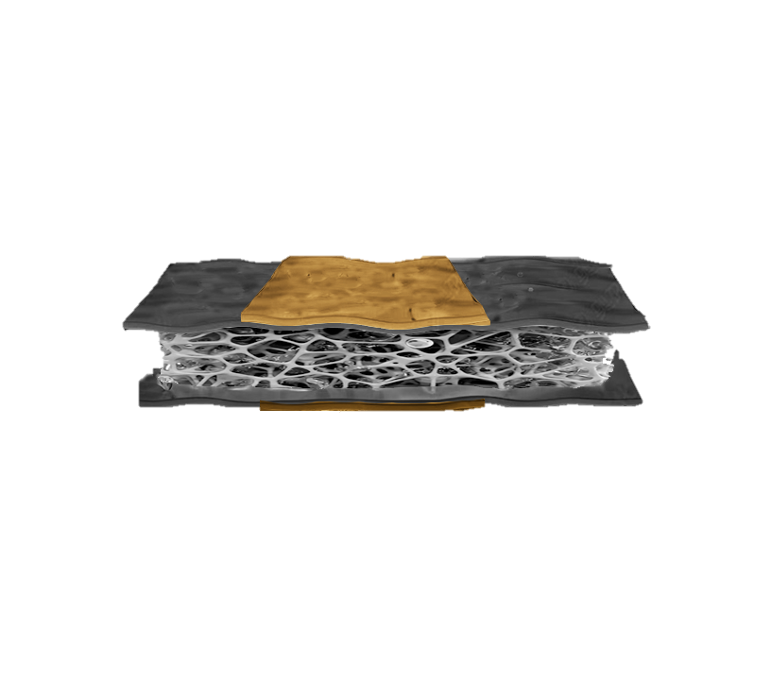
(a)
Initial Structure
(b)
(c)
Patch
6mm
+
+
d
C_{o}
CNT foam
Pressure Sensor
-
-
(d)
Applied Pressure
5mm
CNT@
PDMS
+
+
C_{p}
d
-
-
SEM of the CNT

Slide 2
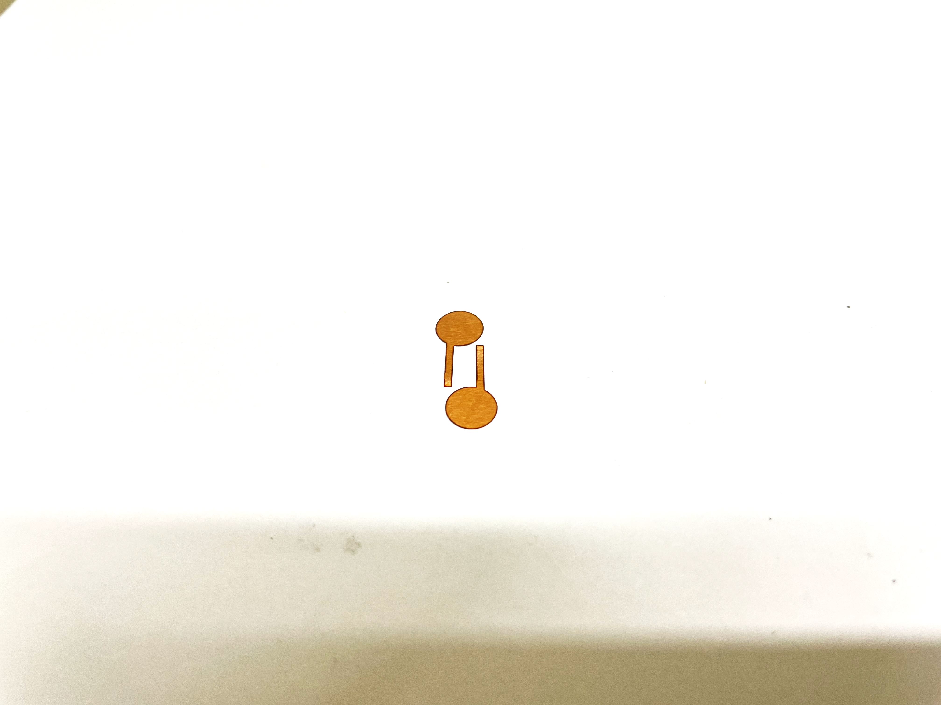
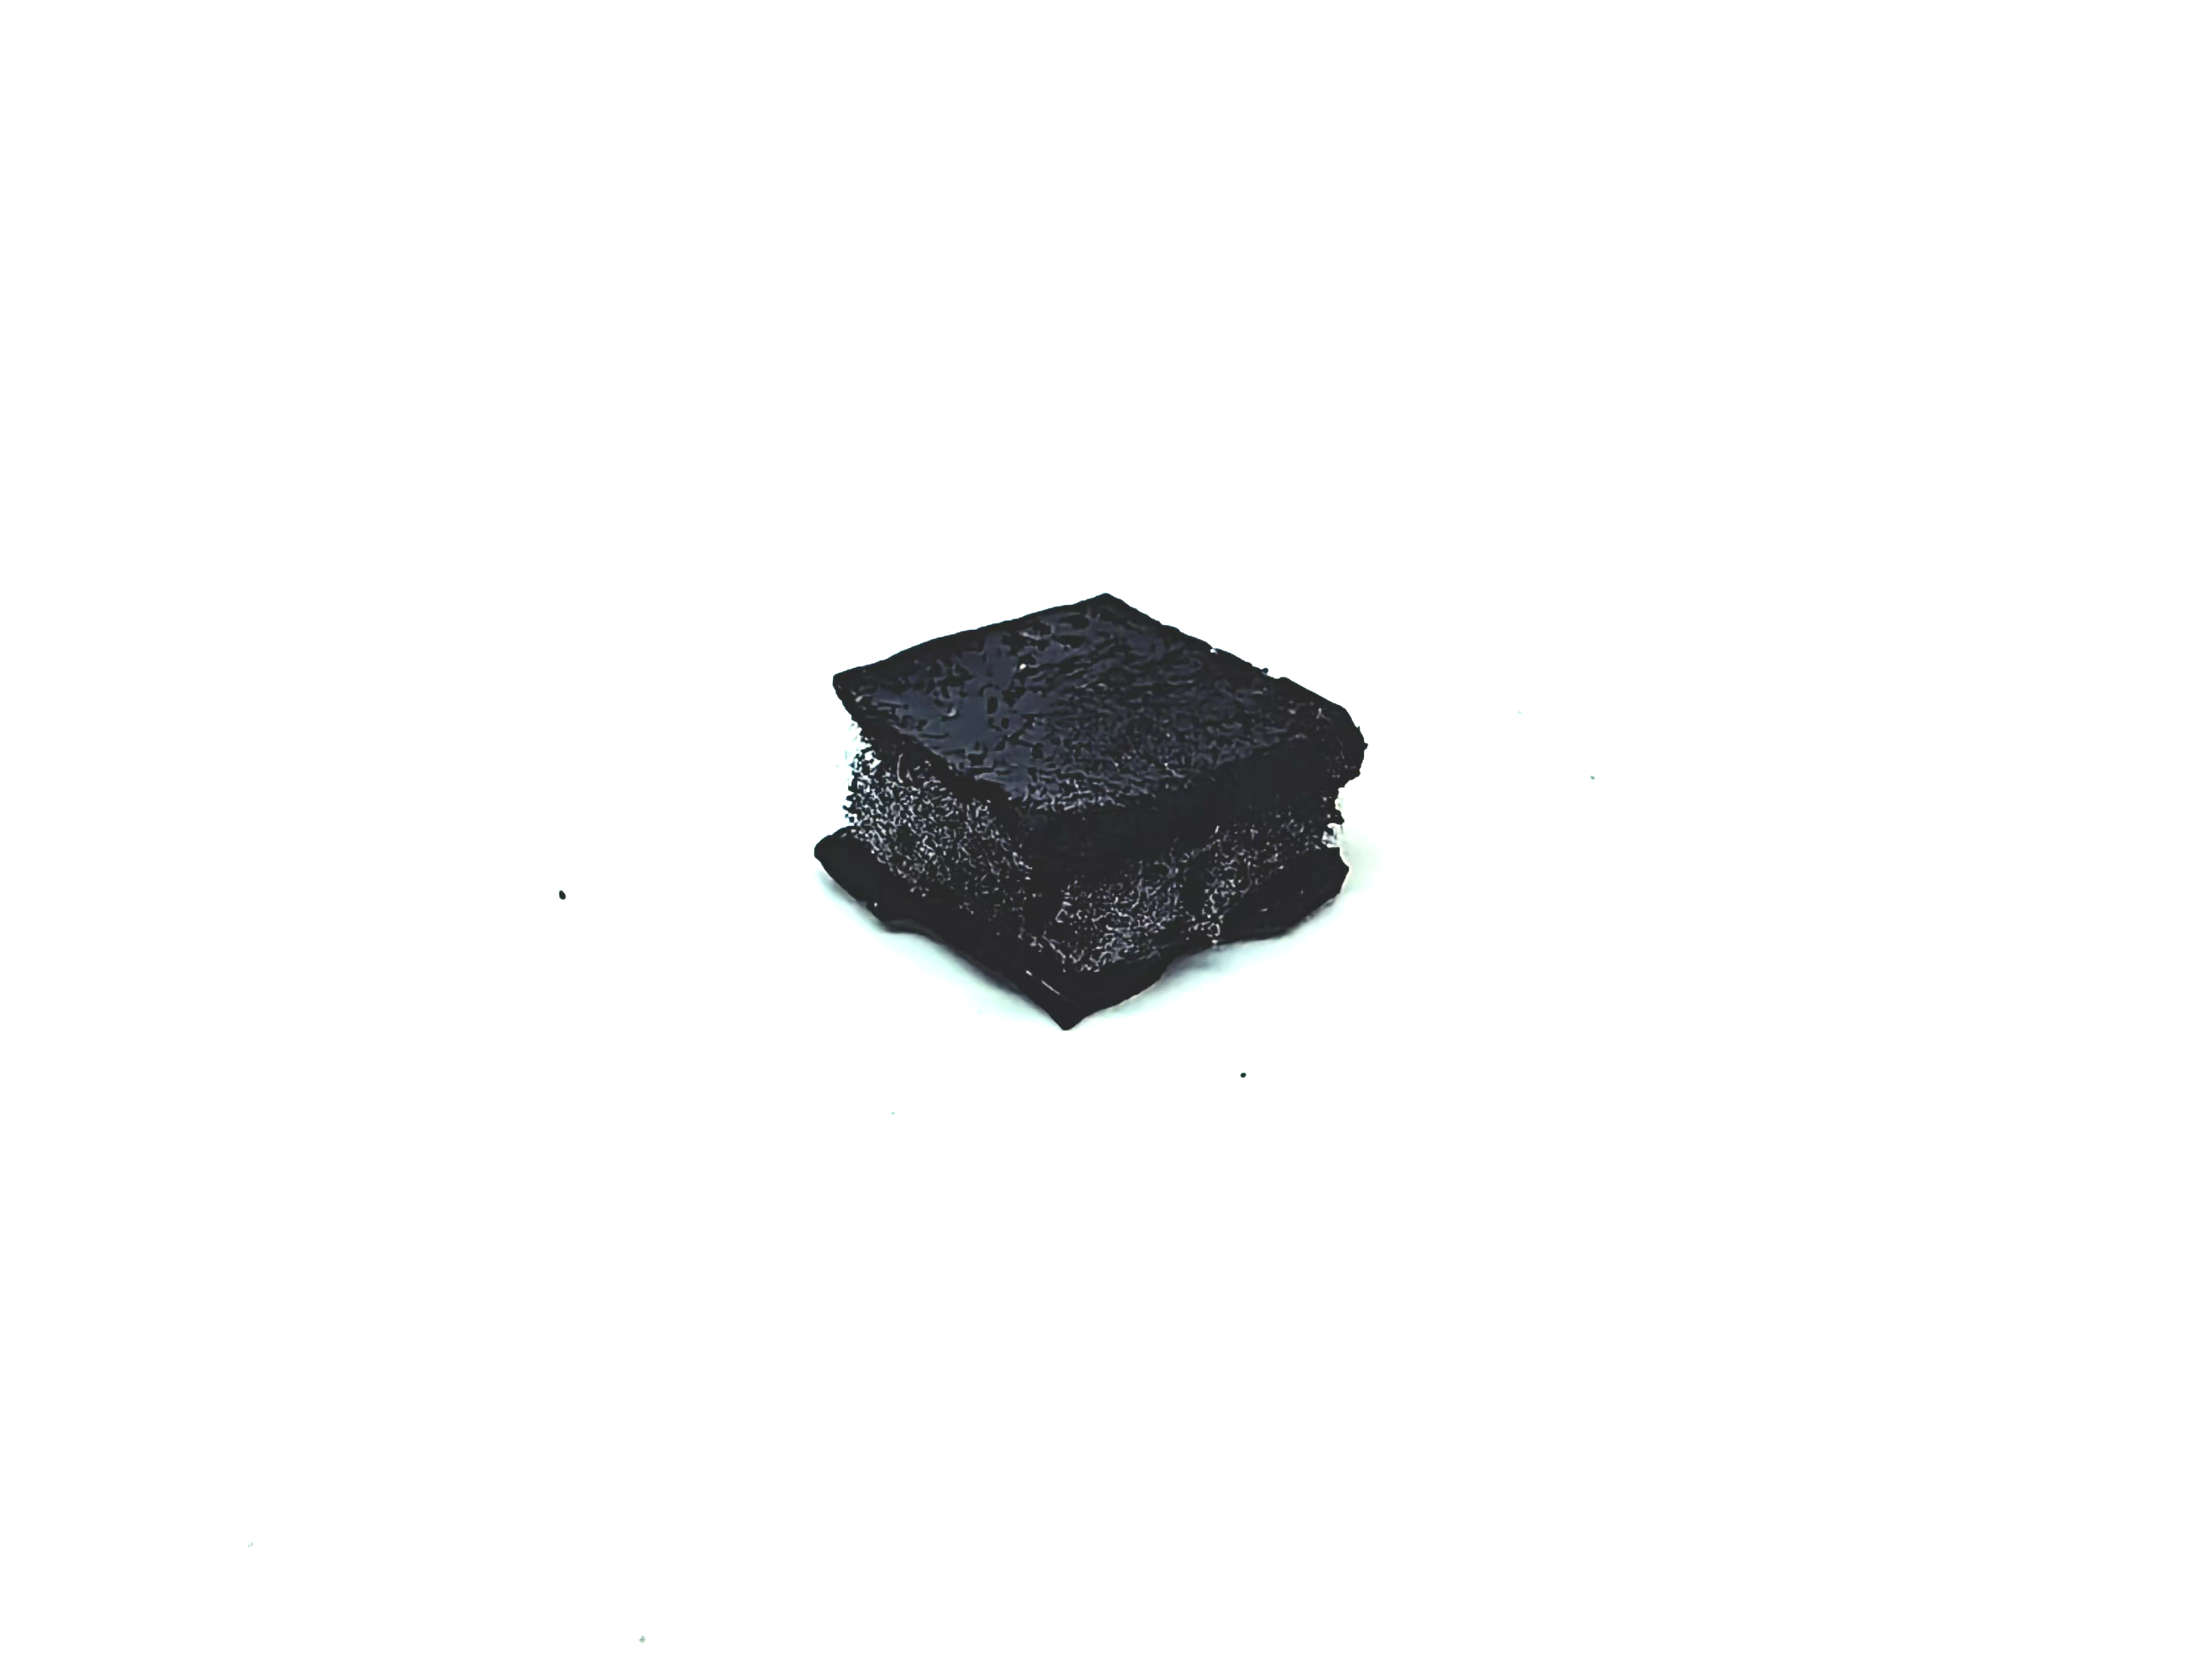
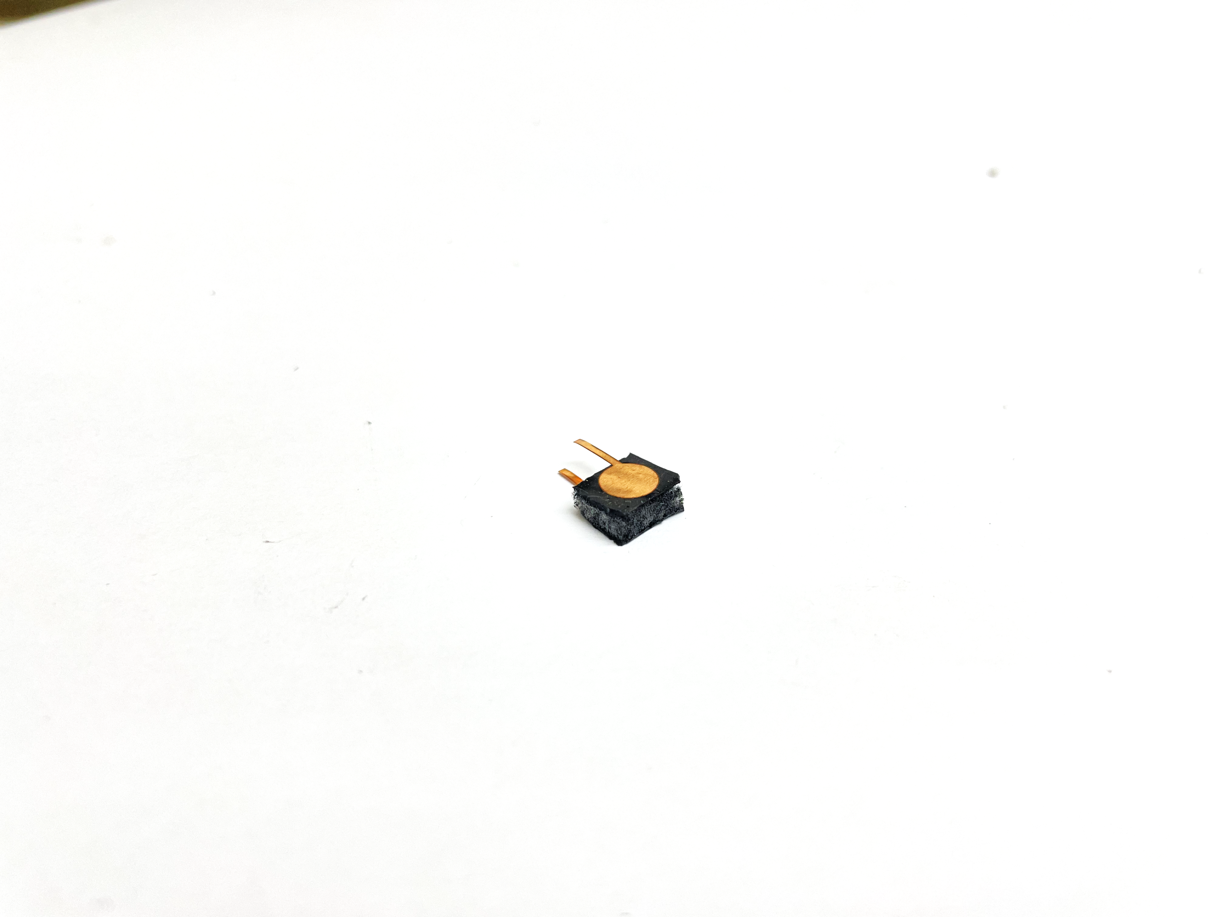
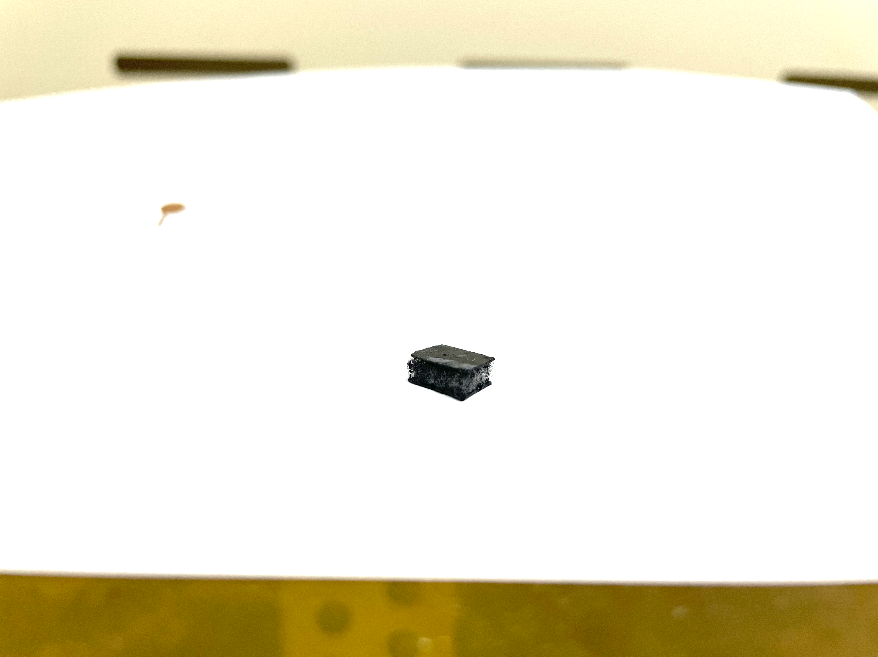
(a)
Initial Structure
(b)
(c)
Patch
6mm
+
+
d
C_{o}
CNT foam
Pressure Sensor
-
-
(d)
Applied Pressure
5mm
CNT@
PDMS
+
+
C_{p}
d
-
-
SEM of the CNT

Slide 3
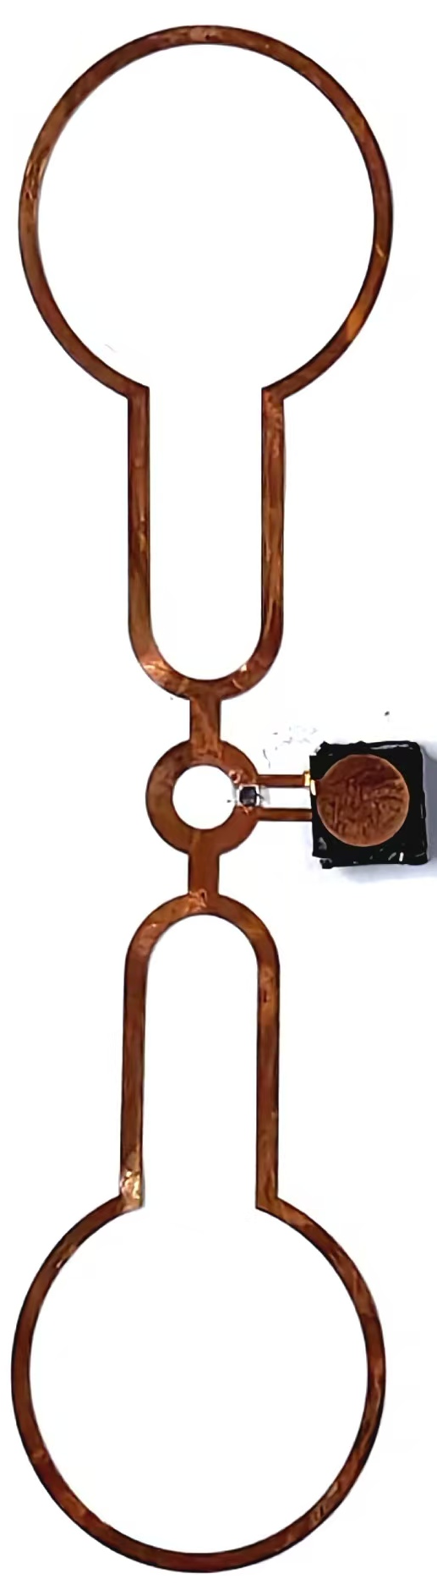
(a)
Initial Structure
(b)
(c)
Patch
6mm
+
+
d
C_{o}
CNT foam
Pressure Sensor
-
-
(d)
Applied Pressure
5mm
CNT@
PDMS
+
+
C_{p}
d
-
-
SEM of the CNT

Slide 4
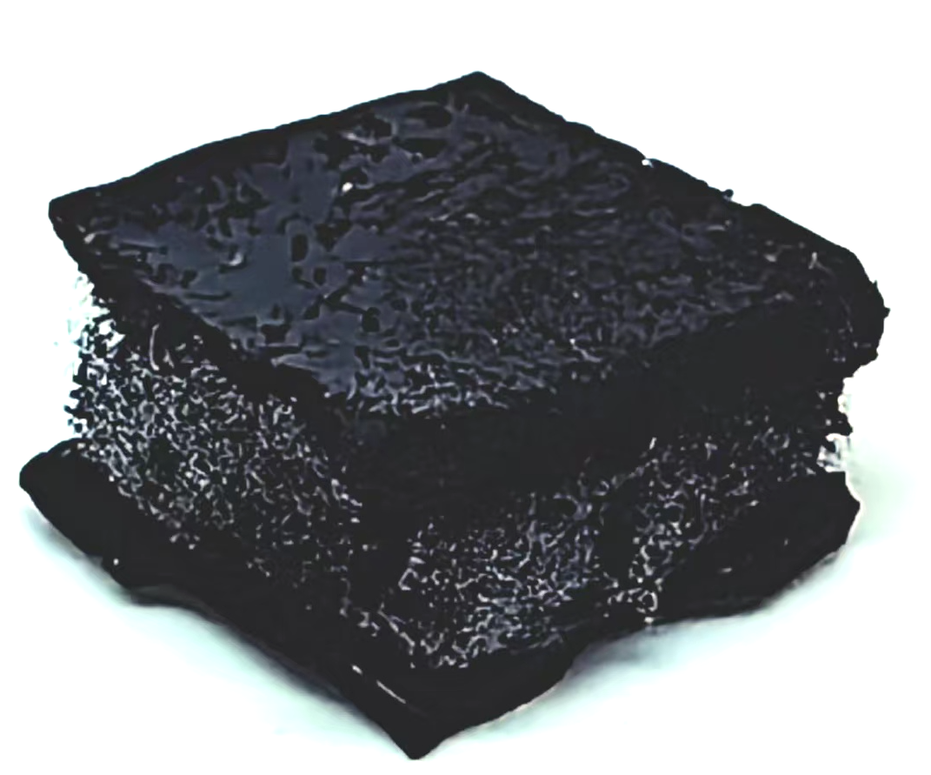
(a)
Initial Structure
(b)
(c)
Patch
6mm
+
+
d
C_{o}
Pressure Sensor
CNT foam
-
-
(d)
Applied Pressure
5mm
CNT@
PDMS
+
+
d
C_{p}
-
-
SEM of the CNT

Slide 5
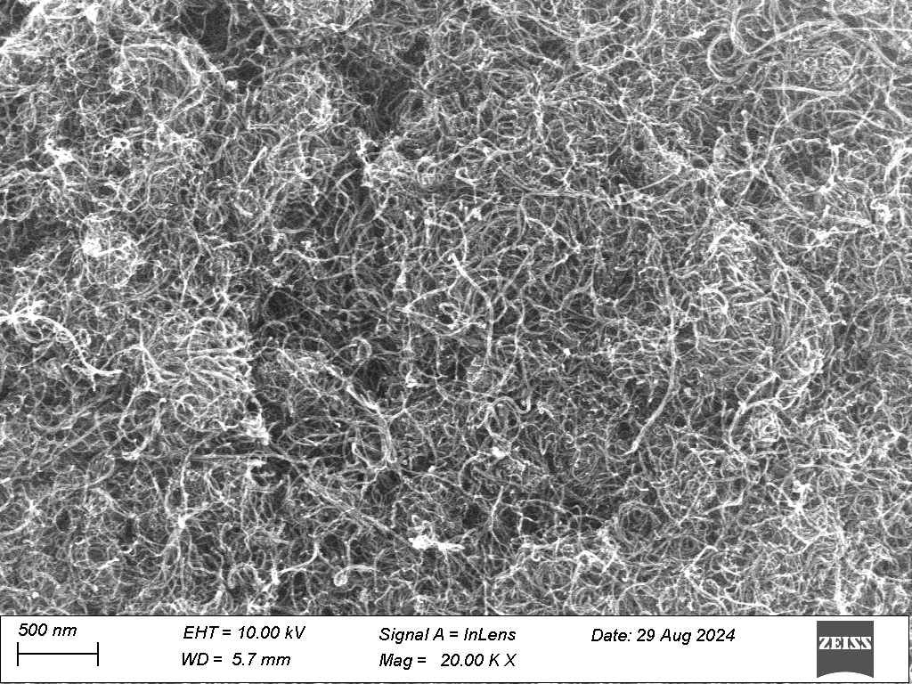

Slide 6
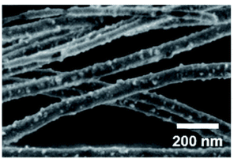
(a)
Initial Structure
(b)
(c)
Patch
+
+
d
C_{o}
Pressure Sensor
CNT foam
(d)
-
-
Applied Pressure
CNT@
PDMS
+
+
d
C_{p}
-
-
SEM of the CNT

Slide 7
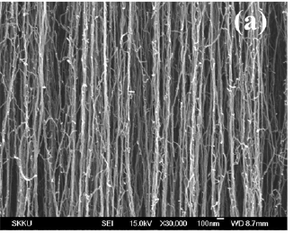
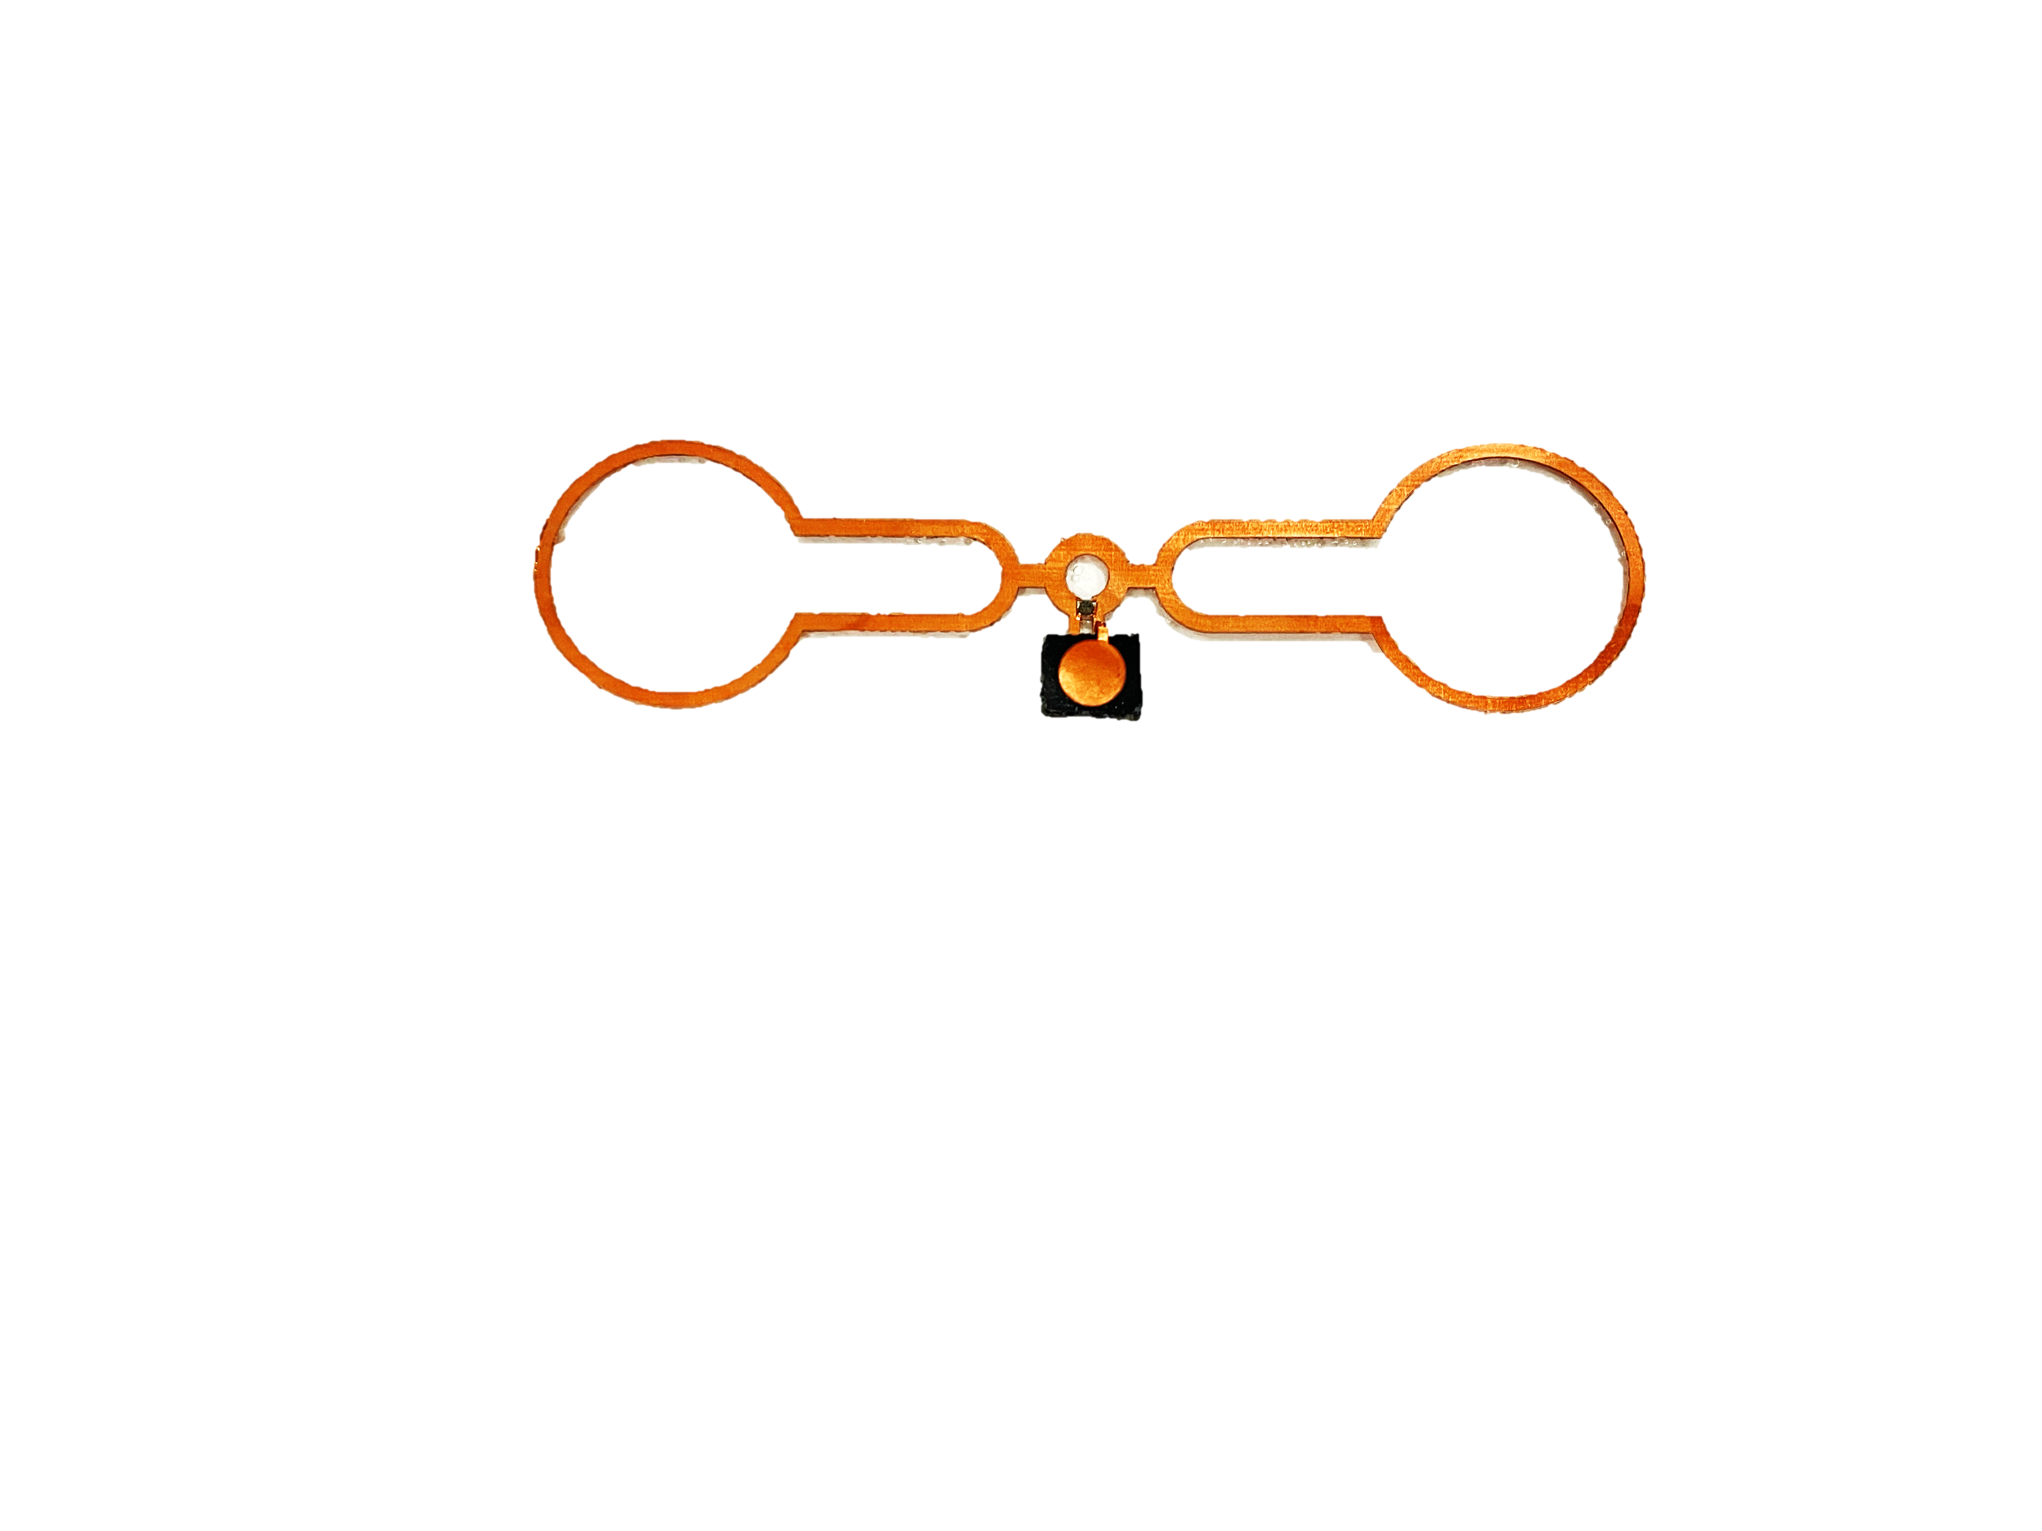
Patch
Initial Structure
C_{o}
Pressure Sensor
C_{o}
Applied Pressure
CNT@
PDMS
C_{F}
C_{F}
10mm
3mm
6mm
10mm

Slide 8
10mm
Copper patch
PDMS
10mm
CNT foam
Pressure Sensor
Applied Pressure
3mm
6mm
CNT@
PDMS
Patch

Slide 9
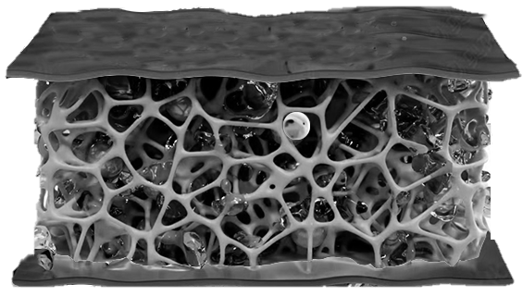
10mm
6mm
3mm
10mm
CNT@
PDMS
Pressure Sensor
Patch

Slide 10
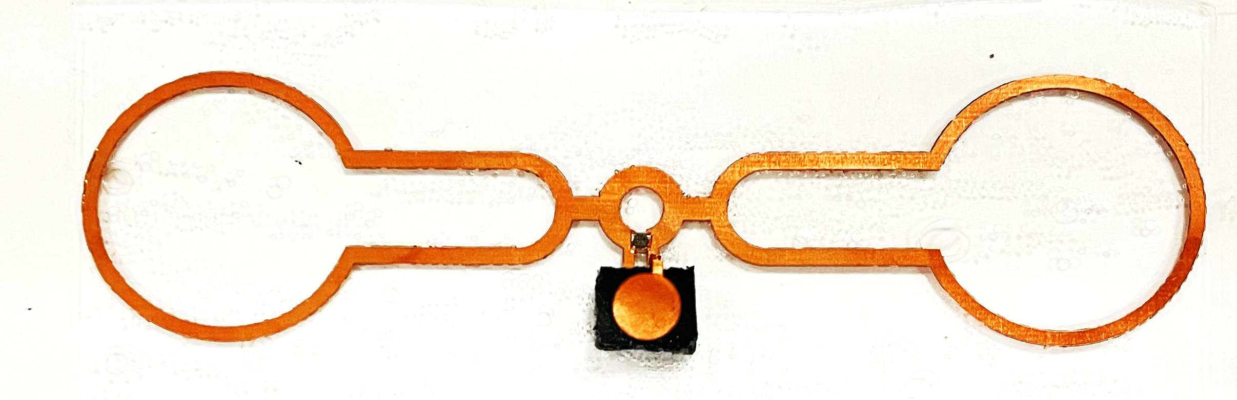
6mm
10mm
3mm
10mm
CNT@PDMS
Patch
Pressure sensor

Slide 11
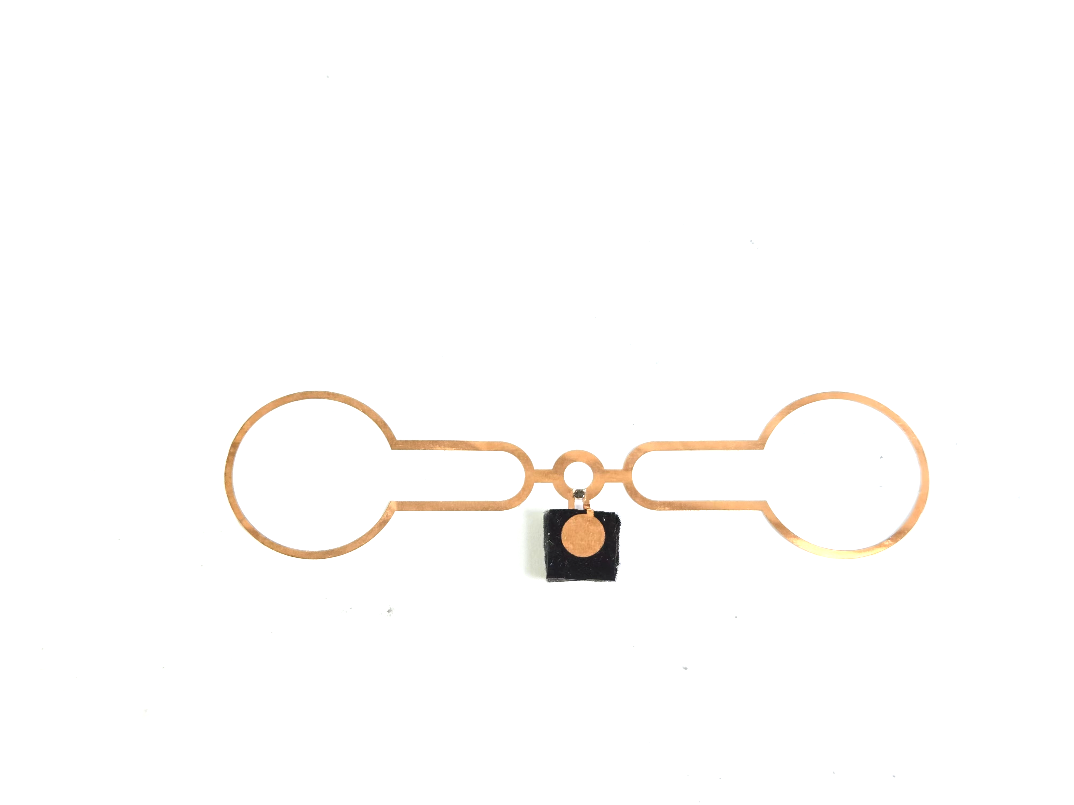
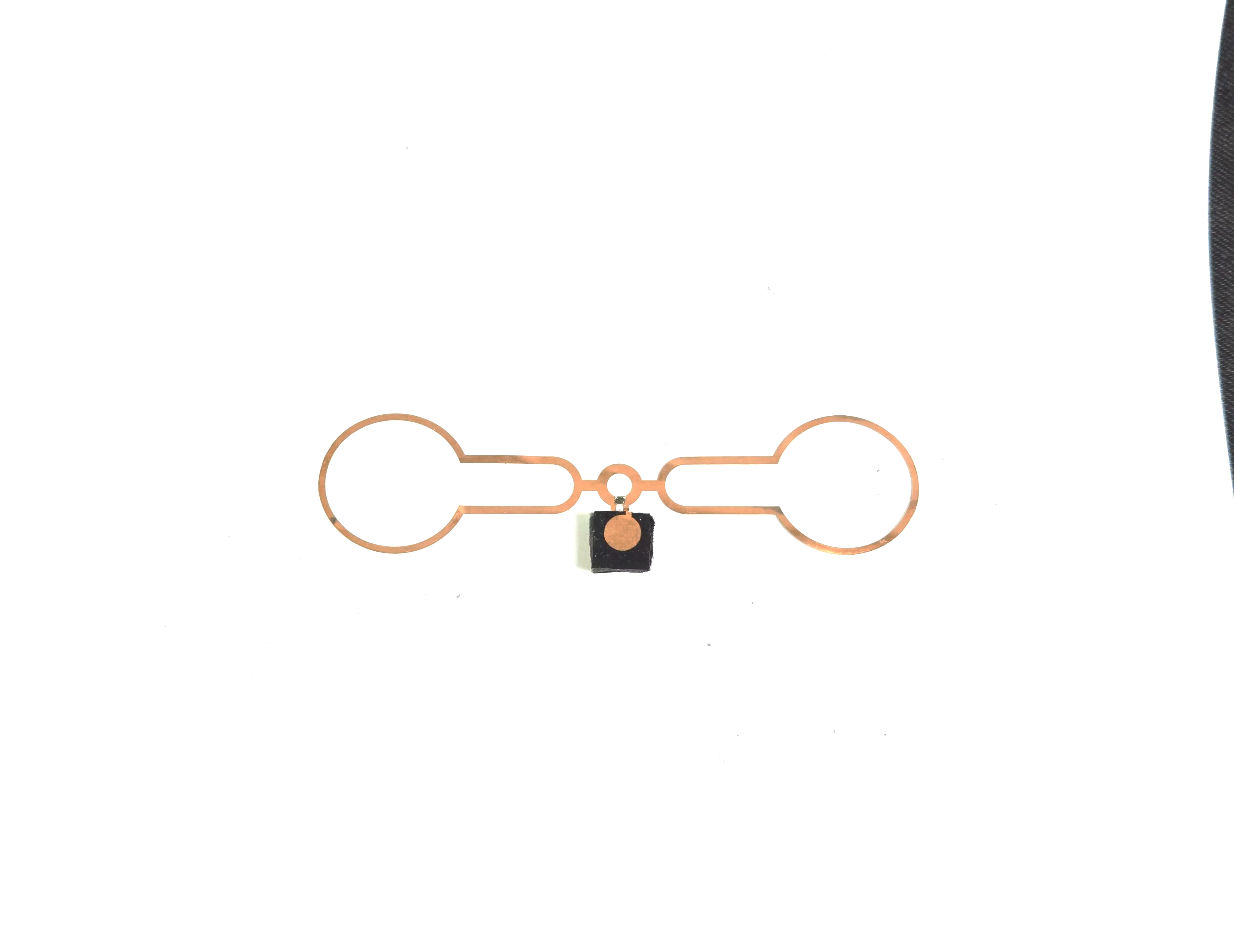
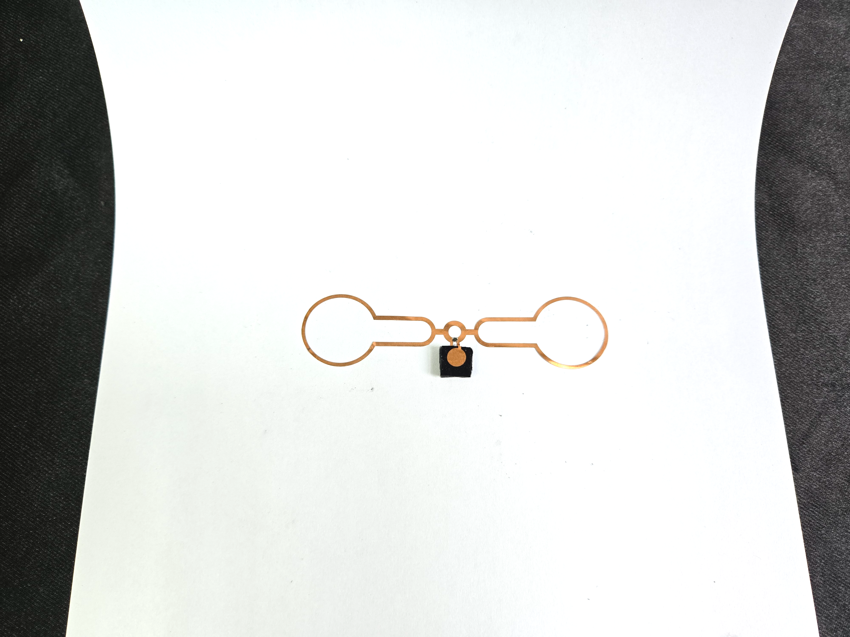
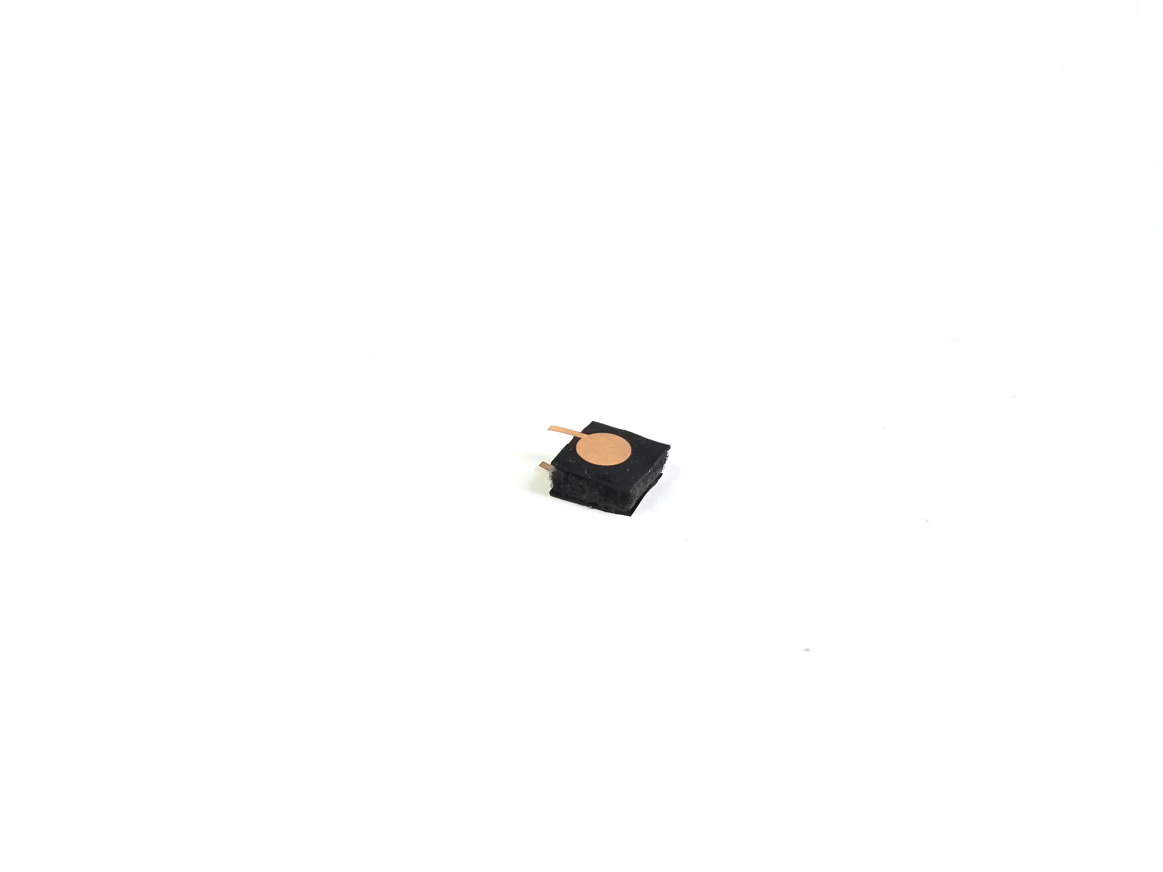
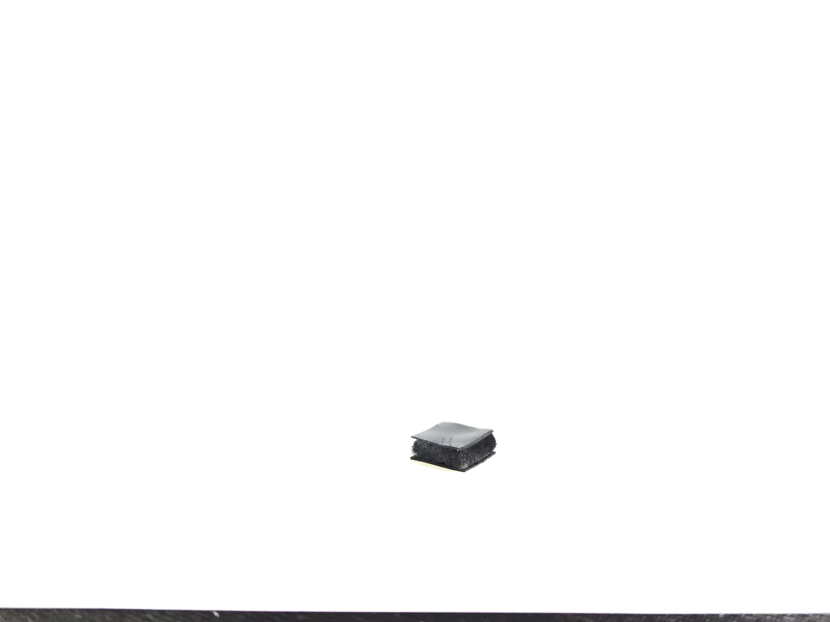
6mm
10mm
3mm
10mm
CNT@PDMS
Patch
Pressure sensor

Slide 12
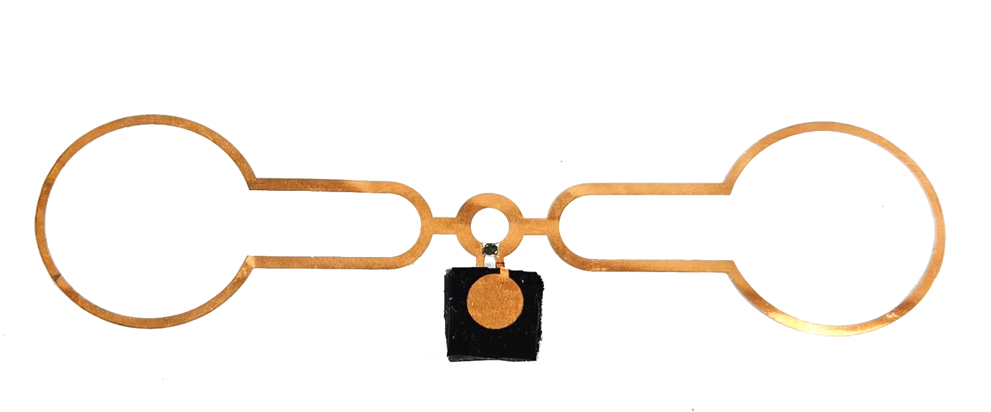
6mm
10mm
3mm
10mm
CNT@PDMS
Patch
Pressure sensor

